Slide 1


如何提昇研究競爭力－活用 WOS、JCR、DCI 及 ResearcherID
Web of Science Core Collection
& Journal Citation Report
& EndNote Online & ResearchID
2014年11月

Slide 2
大 綱
For研究人員_加速研究流程
For研究人員_追蹤發表作品
For單位系所_評鑑產出質量

Slide 3
[Part 1]
For研究人員_加速研究流程
For研究人員_追蹤發表作品
For單位系所_評鑑產出質量

Slide 4
整合Web of Science平台工具
WOS核心合輯
背景問題知識補充
EndNote
加速文章發表時間
JCR
評估投稿期刊
ResearcherID
增加文章曝光率
DCI

Slide 5
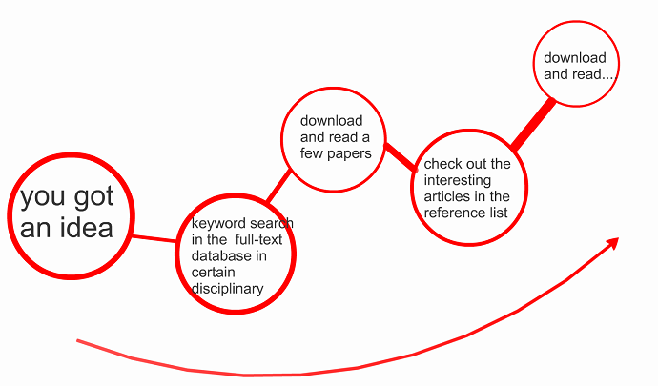
Can this process be improved ?

Slide 6
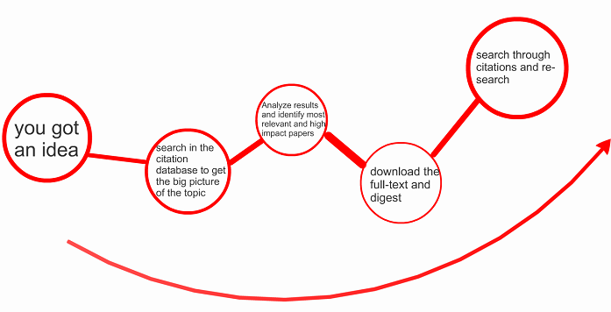
Is it a more efficient way for research ?

Slide 7
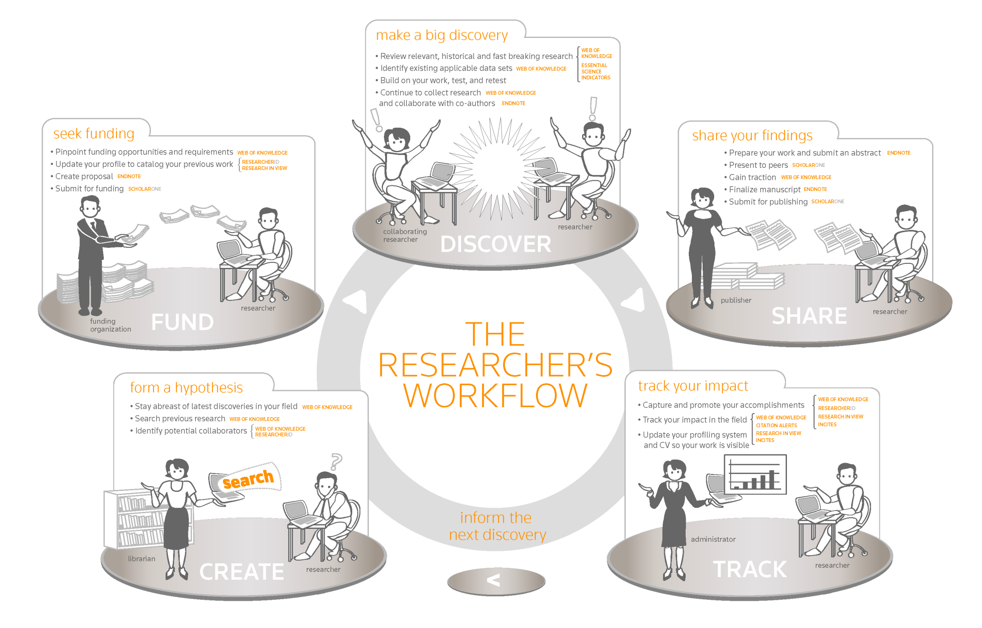
Implement it in your daily work flow …

Slide 8
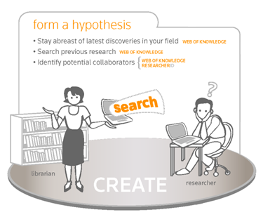
Retrieve the relevant papers in your area
Zoom quickly into the high impact papers
Trace the progress of a research with citations

Slide 9
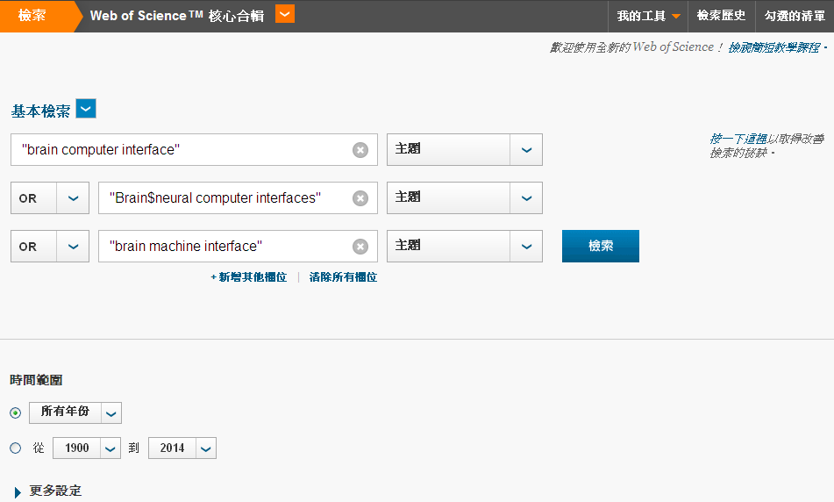
Search by Topic
Notes:
Brain computer interface
Brain neural computer interfaces
Brain machine interface

Slide 10
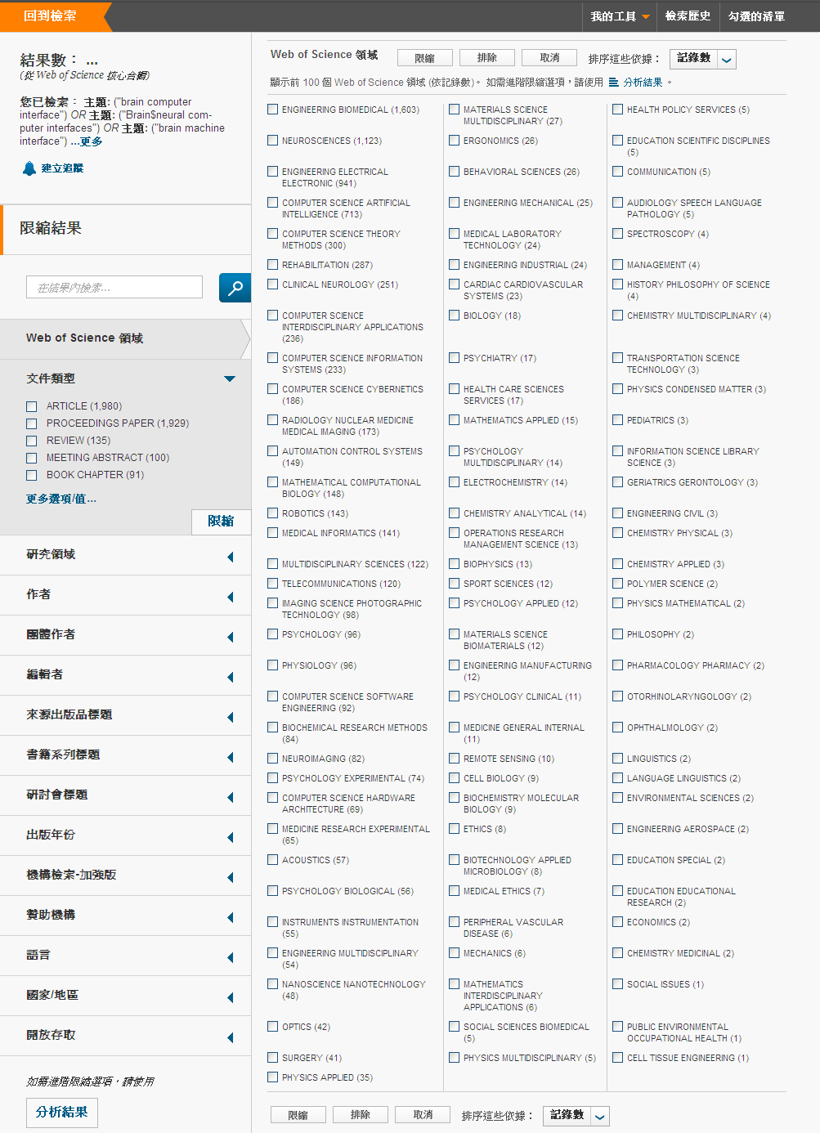
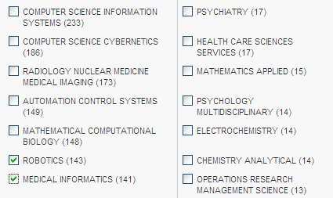
1. Retrieve the relevant papers in your area

Slide 11
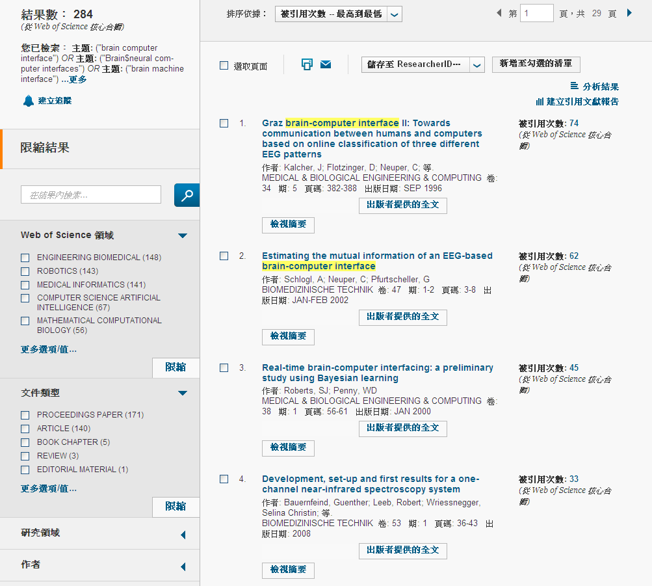
2. Zoom quickly into the high impact papers

Slide 12
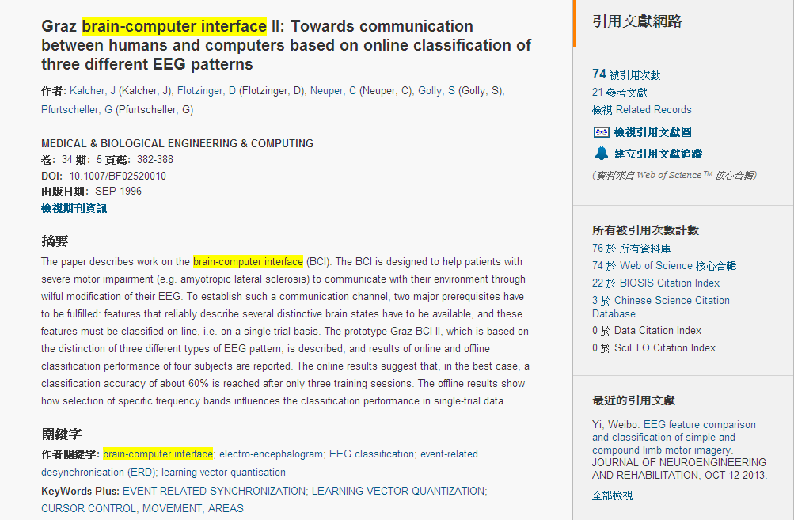
3. Trace the progress of a research with citations

Slide 13
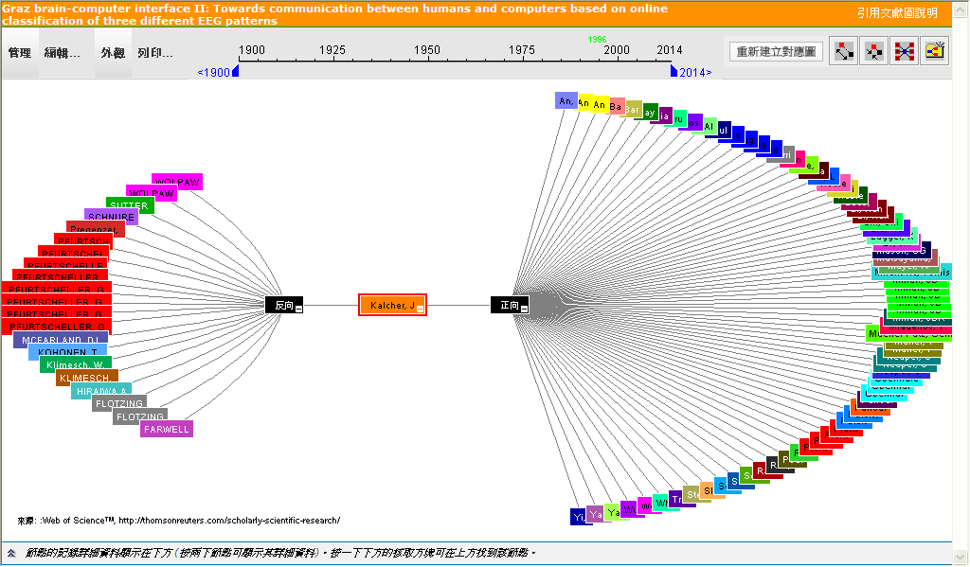
Citation Map

Slide 14
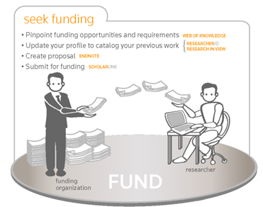
Research background information for a subject ?
Analysis of development trends ?
Choosing funding agencies ?
Looking for collaborators?

Slide 15
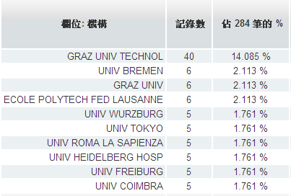
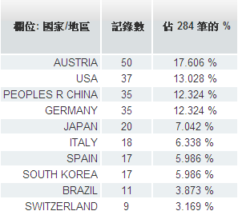
Research background information for a subject
Key institutions
Countries active in this field

Slide 16
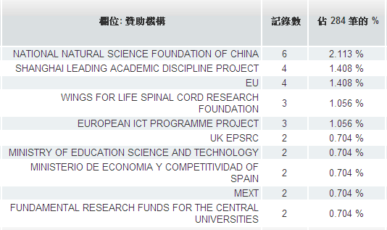
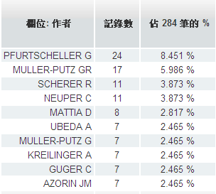
Looking for funding agencies ?
Potential collaborators ?

Slide 17
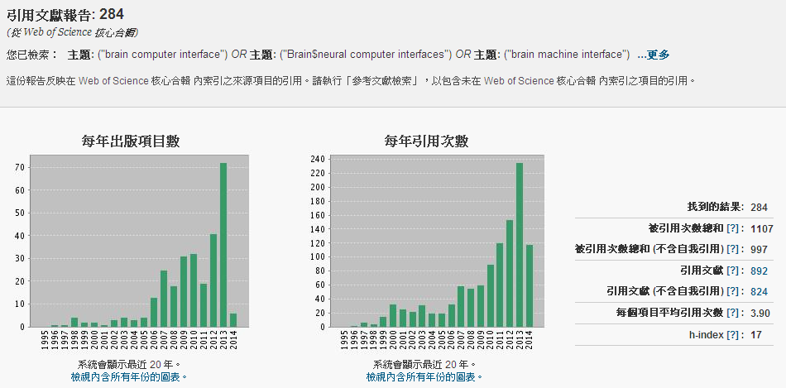
Analysis of development trends

Slide 18
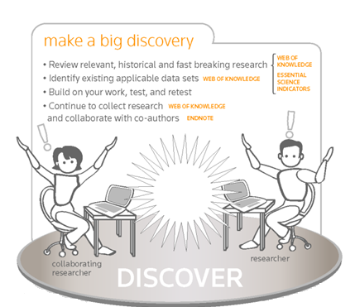
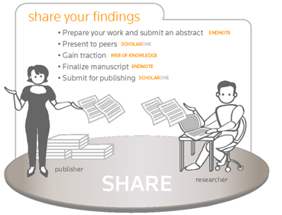
Where should I submit my publication?
Manage references painlessly and happy writing

Slide 19
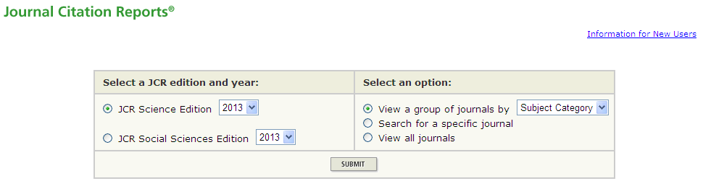
Where should I submit my publication?
Target at the high impact factor journals for submission
Higher citations rate means your article has higher chances of getting cited
Higher reading rate means your article get read by more researchers
More international recognition in terms of scholarly contribution

Slide 20
Some factors to consider before article submission …
Journal Impact Factor
5 Year Journal Impact Factor
Immediacy Index
Eigenfactor Metrics, etc…

Slide 21
情境一：我想知道我所屬的領域中，哪些是高影響力的期刊？
一
用IF指標排序
找到排名前面的高影響力期刊
確認領域
三
二

Slide 22
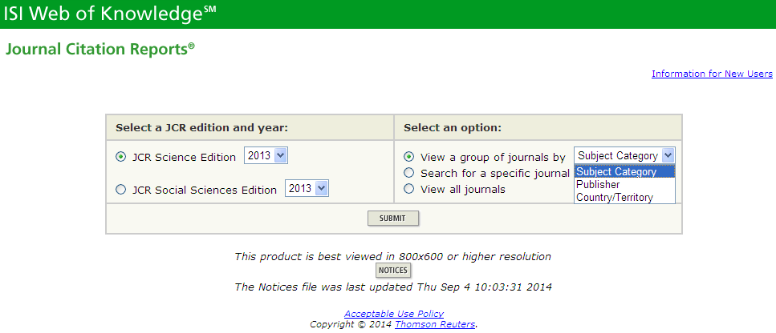

Slide 23
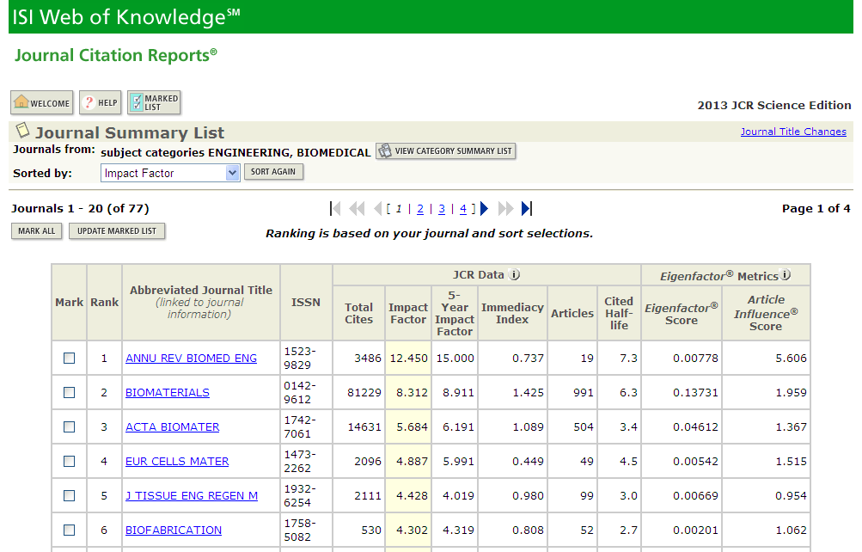
Journals in ENGINEERING, BIOMEDICAL
Notes:
Engineering, Biomedical
Category Description:
Engineering, Biomedical covers resources that apply engineering technology to solving medical problems. Resources in this category span a wide range of applications including applied biomechanics, biorheology, medical imaging, medical monitoring equipment, artificial organs, and implanted materials and devices.
工程，生物醫學
分類描述：
工程，生物醫學工程涉及的技術，應用到解決醫療問題的資源。這一類資源涵蓋了廣泛的應用，包括應用生物力學，生物流變學，醫學影像，醫療監控設備，人造器官，植入材料和器件。

Slide 24
情境二：我想知道我常常閱讀的期刊或是我有意想投稿的期刊是否為熱門期刊？
一
找到IF指數
點選Journal Ranking
確認期刊名稱(全、簡稱、ISSN)
三
二
Notes:
NATURE REVIEWS DRUG DISCOVERY 1474-1776

Slide 25
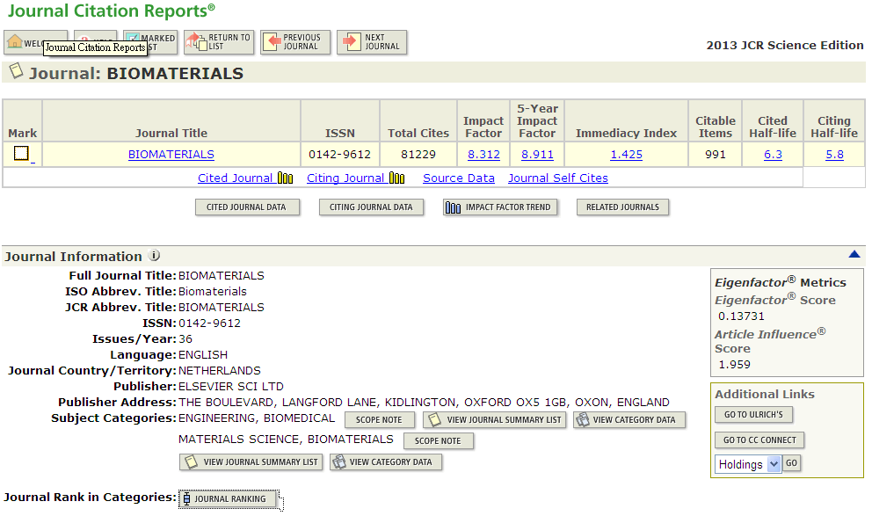
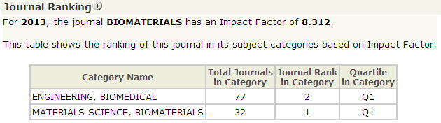

Slide 26
情境三：我在幾本期刊之間猶豫，不知道該投稿到哪本期刊比較好？
一
比較Journal Self Cites百分比
利用Article Influence Score排序
三
二
四
考量Impact Factor Trend
考量Immediacy Index
Notes:
NATURE REVIEWS DRUG DISCOVERY 1474-1776

Slide 27
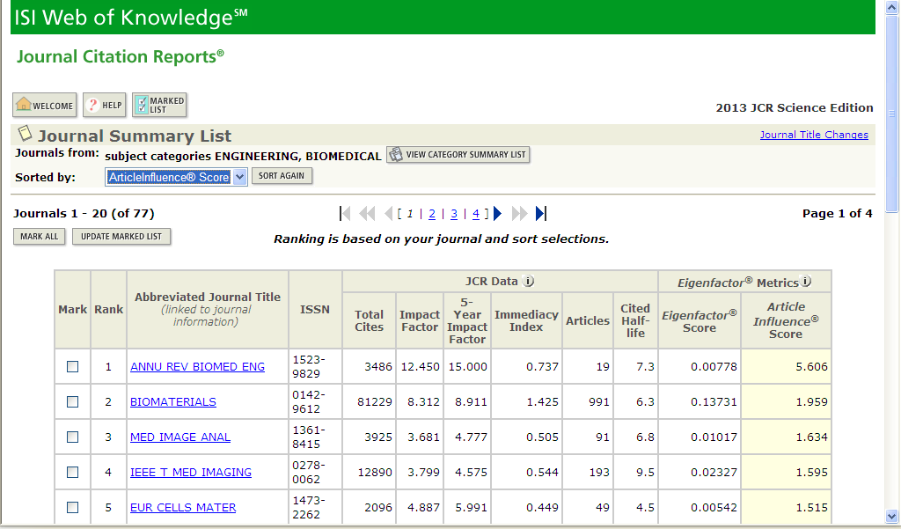
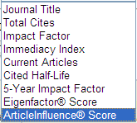
Article Influence Score

Slide 28
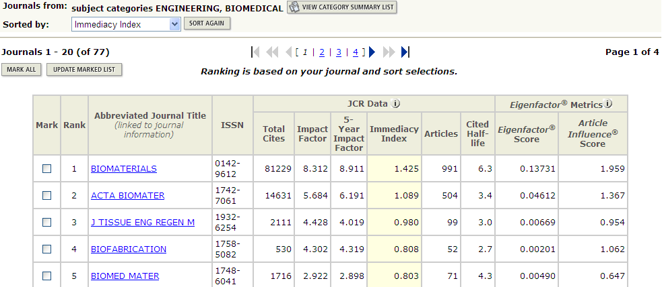
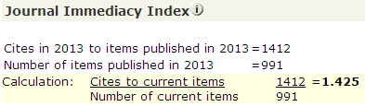
Immediacy Index

Slide 29
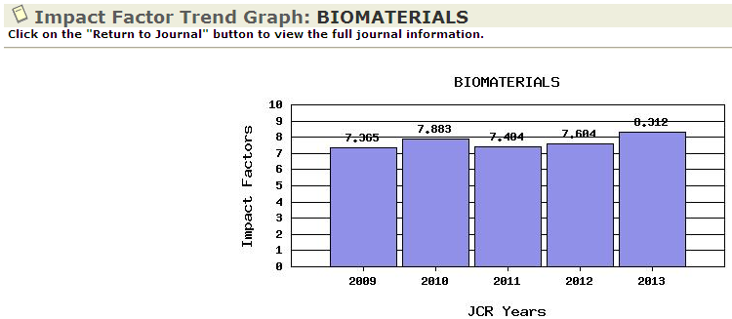
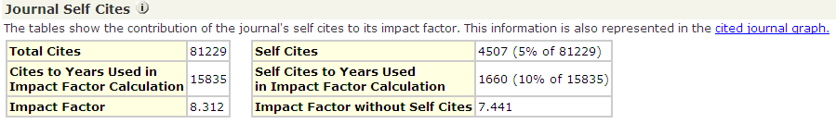

Slide 30
重點整理
不是所有的期刊都會被收進JCR
請在同一個領域下比較各項指標
善用各項指標交叉比對以減少風險

Slide 31

Manage references painlessly and happy writing
Use EndNote Online
Add References to your EndNote Online Library
Organize References in your EndNote Online Library
Insert Citations and References in your Paper
Change the Reference Style

Slide 32
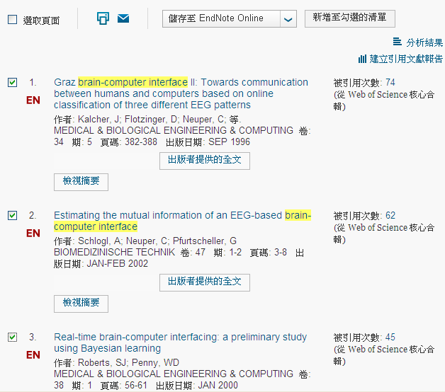
(1) Add References to your EndNote Online Library
1
2

Slide 33
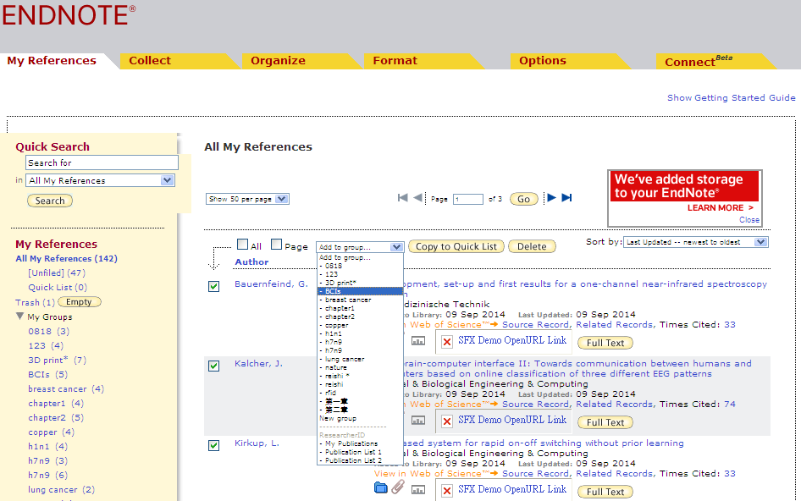
(2)Organize References in your EndNote Online Library
4
3
5

Slide 34
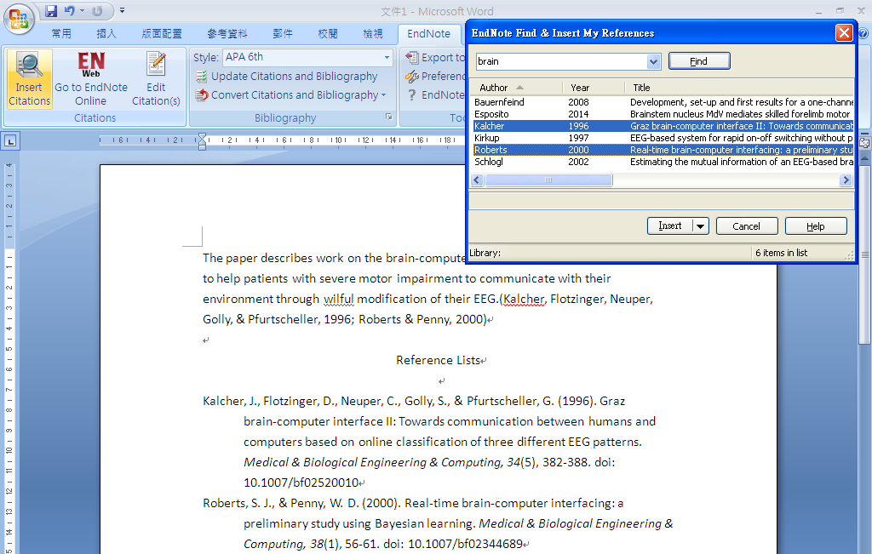
(3)Insert Citations and References in your Paper
7
8
6

Slide 35
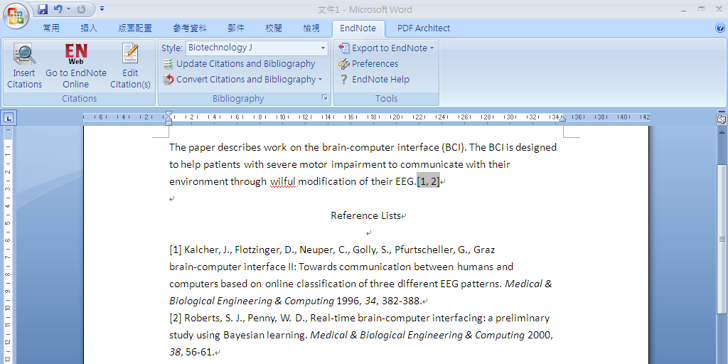
(4) Change the Reference Style
9

Slide 36
重點整理
請先在WOS平台申請帳密，才能使用EndNote Online
若單位未訂購單機版，請先下載並安裝Cite While You Write程式
若有訂購單機版，可在Word工具列切換為EndNote Online

Slide 37
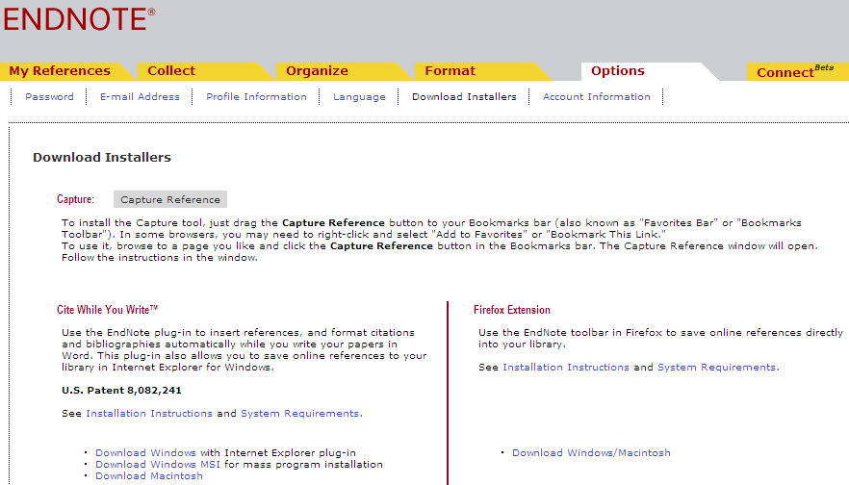
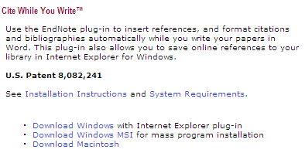
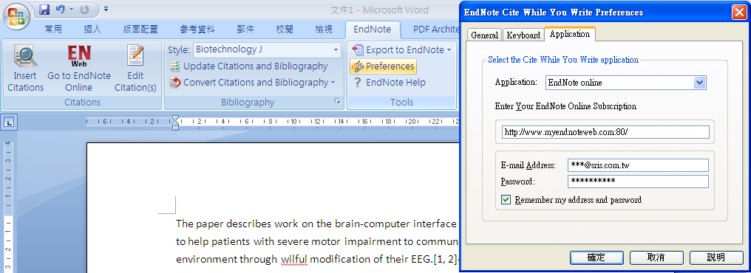

Slide 38

How many times your papers have been cited?
Who cited your articles?
How to promote your publications with a live CV ?

Slide 39
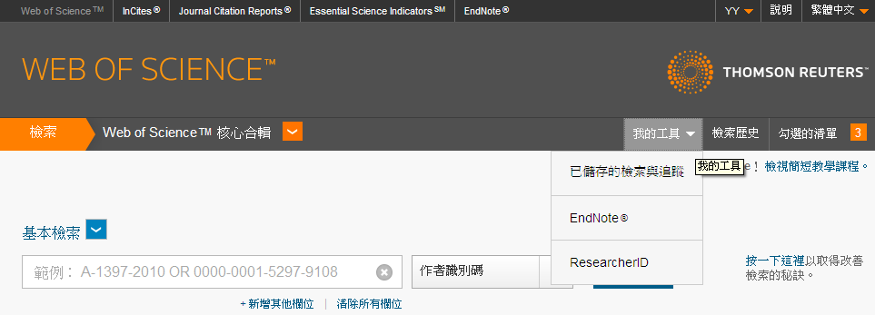
How to promote your publications with a live CV ?
With ResearcherID, you can:
Solve author names misidentification
Promote your research publications
Build collaboration opportunities and be identified

Slide 40
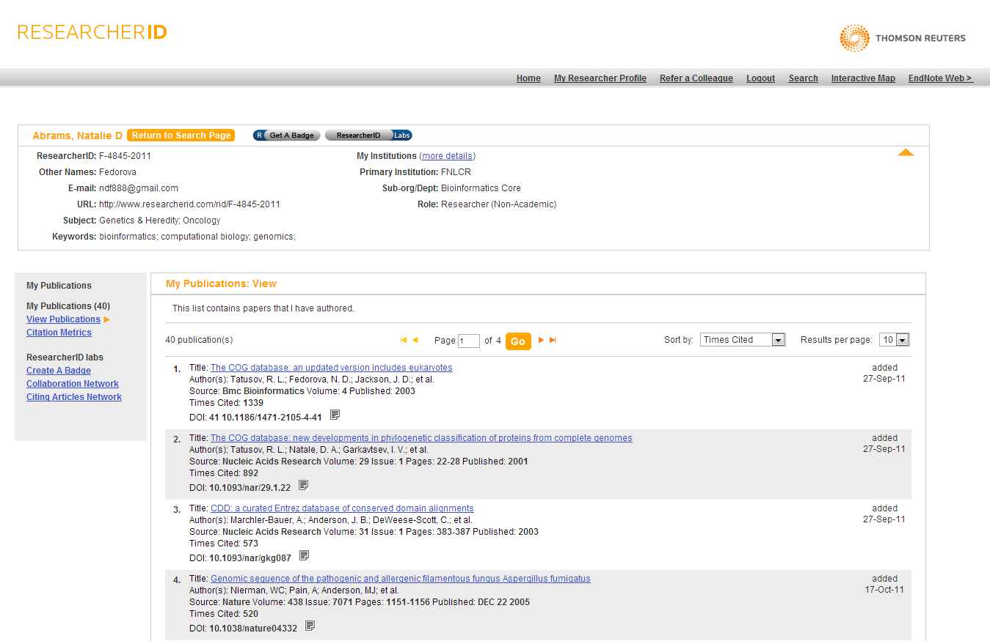
Add every publication once and the Times Cited will be updated automatically

Slide 41
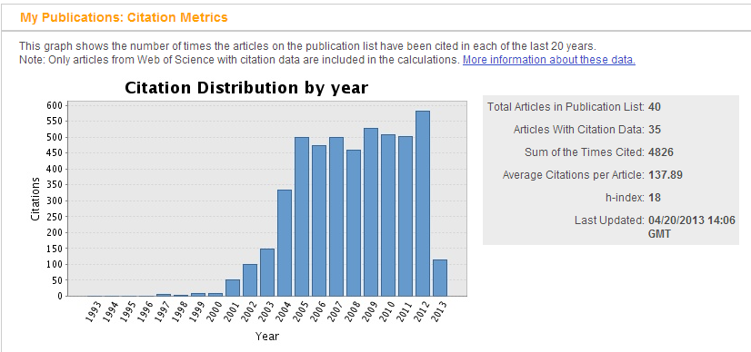
Create an accurate Citation Metrics
Understand your performance progress!

Slide 42
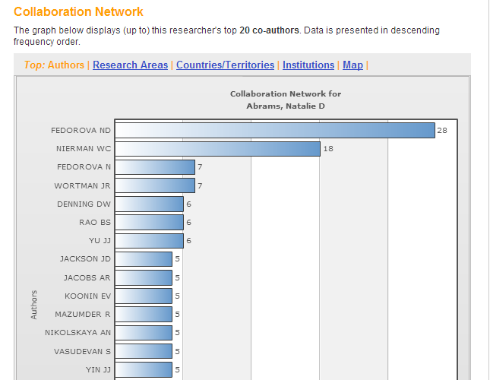
Collaboration Network
Understand and appreciate:
Who are key collaborators?
Major focus of study or research strength
Network distributions
Top collaboration institutes

Slide 43
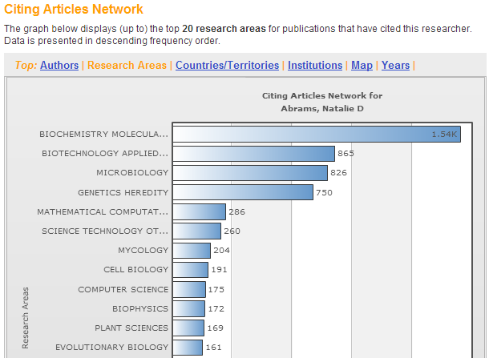
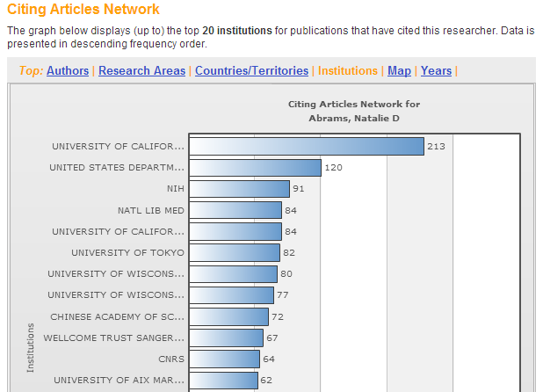
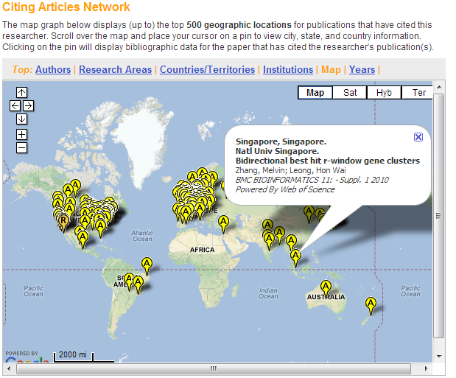
Citing Articles Network

Slide 44
Efficient & Quality Literature Search for “Smart Discovery”
Manage References and Happier Writing Process
Target at the Right (High Impact Factor) Journals
Be Seen, Be Cited and Be Identified!
Web of Science Workflow in Improving research Performance

Slide 45
“Smart Discovery”
(Web of Science Core Collection)
Happy Writing
(EndNote Online)
Right IF Journals (Journal Citations Report)
Increase Visibility
(ResearcherID)
Web of Science Workflow in Improving research Performance

Slide 46
[Part 2]
For研究人員_加速研究流程
For研究人員_追蹤發表作品
For單位系所_評鑑產出質量

Slide 47
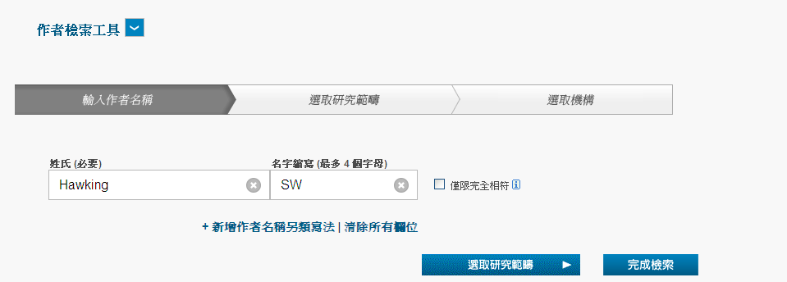
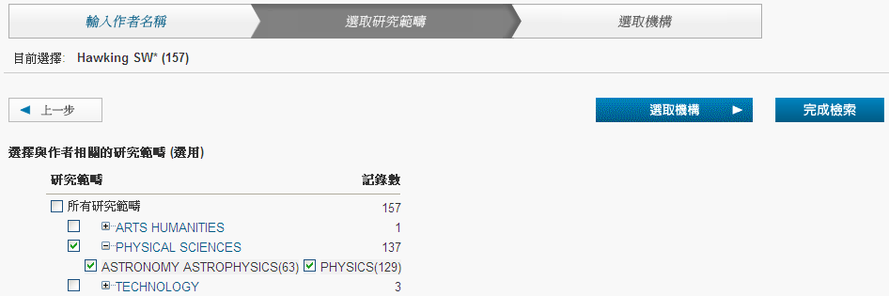
作者查詢三步驟
1
2

Slide 48
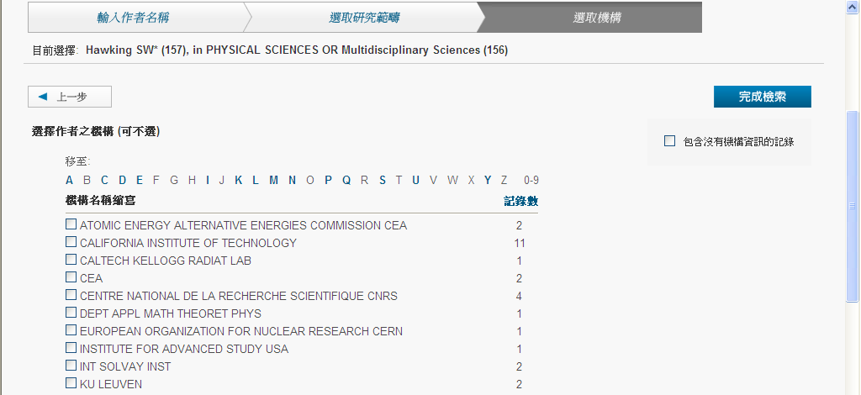
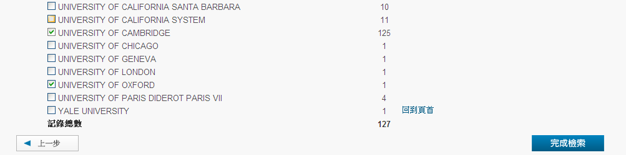
3

Slide 49
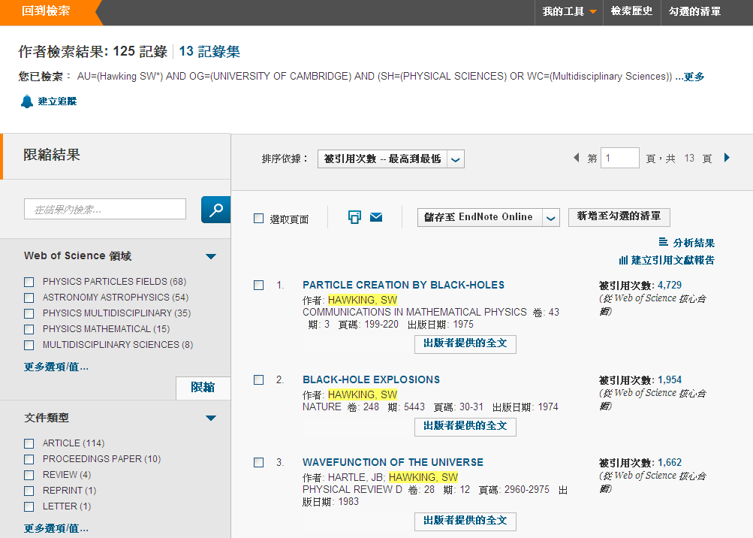
作者作品之被引狀況

Slide 50
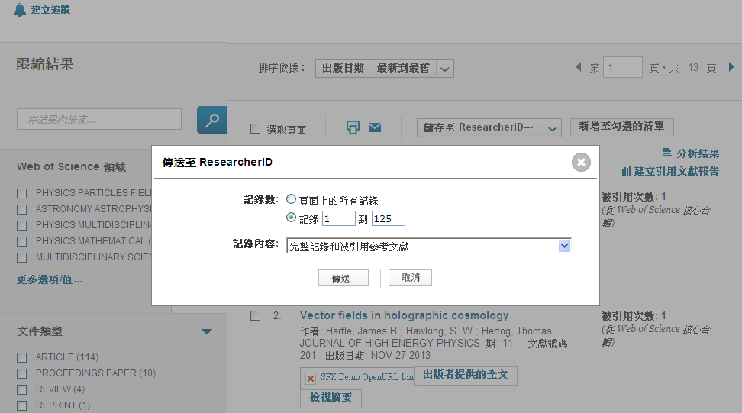
將作品上傳至ResearcherID

Slide 51
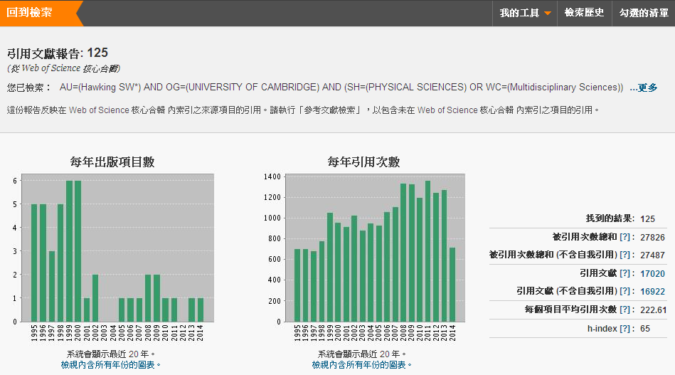
得知作者整體論文發表的質與量
Notes:
將被引用的文章按照引用次數排序，引用次數高的排在最前面，引用次數少的排在最後，從排序的結果可看出被引用的文章「至少有h篇文章被引用h次」。可以利用 h-index 得知某一作者或系所整體論文發表的質與量喔。

Slide 52

作者作品之歷年被引狀況

Slide 53
重點整理
利用「作者檢索」查自己的作品是否被收錄與被引狀況
查詢：姓在前(完整姓氏)，名在後(取名字的首字母)
共三步驟：姓名→領域→機構(自己再篩選一次較保險)

Slide 54
[Part 3]
For研究人員_加速研究流程
For研究人員_追蹤發表作品
For單位系所_評鑑產出質量

Slide 55

以清大物理系為例

Slide 56


Slide 57

H-index：66

Slide 58

以台大物理系為例

Slide 59

H-index：86

Slide 60

以師大物理系為例

Slide 61

H-index：41

Slide 62
重點整理
利用 h-index 得知某一作者或系所整體論文發表的質量
請在同一性質或領域下進行比較(清大VS臺大Not師大)
當「甲校 h-index 值大於乙校時，表示甲校的論文整體質量表現較乙校為佳。」

Slide 63
Useful Links
線上影音教材網址
WOS：http://www.customer-support.com.tw/training/sris/
快速指引參考卡網址
WOS：http://www.sris.com.tw/ser_download.asp
JCR：http://www.sris.com.tw/download/jcr_qrc_0909.pdf
JCR：http://www.customer-support.com.tw/training/sris/JCR.php

Slide 64

謝謝大家~
服務專線：02-7731-5800
服務傳真：02-8226-5022
客戶服務信箱：services@customer-support.com.tw

